Slide 1
Textual Criticism and Scholarly Editing
2017-01-25

Slide 2
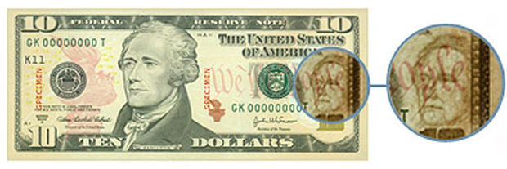
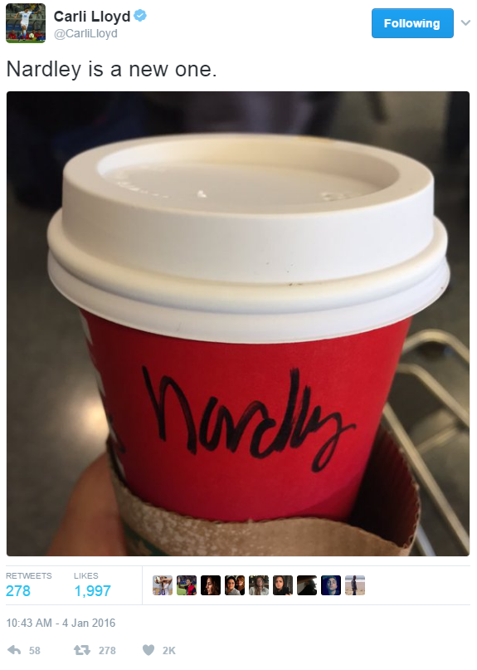

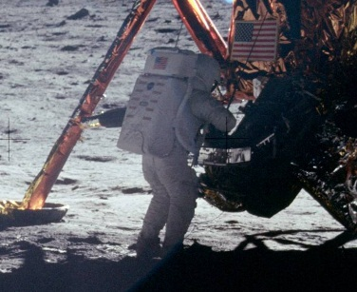

Textual Criticism as a Human Activity

Slide 3
Ontology and Taxonomy of Text and Editing
Approaches to Scholarly Editing
Historical
Reproducing documentary texts w/o alteration
Nonhistorical
Editing by publishing houses
Quoting by some literary critics
Introducing alterations into documentary texts
In facsimile
In literal (diplomatic) transcription
Works viewed as products of individuals
Works viewed as collaborative (social) products
With editorial judgment minimized <- -> maximized
Authors’ originally intended texts reconstructed
Authors’ originally intended texts reconstructed
Authors’ finally intended texts reconstructed
Publishers’, directors’, or others’ texts reconstructed
Texts available to readers at given times reconstructed
Work
Document
Text
Notes:
(Attempts to) convey
Is report of
Presents
(Provides) instructions for the reconstitution of

Slide 4
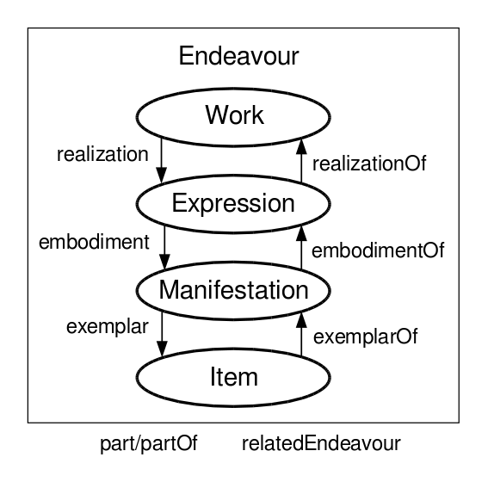
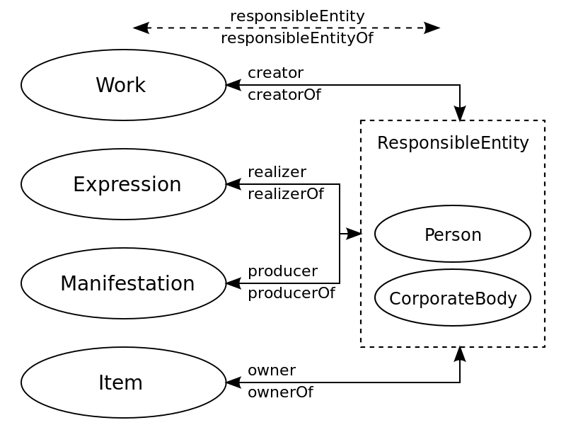
Functional Requirements for Bibliographic Records (FRBR) Ontology

Slide 5
MLA: CEAA/CSE Standards for “Approved Edition/Text” (2003)
A textual essay, which sets forth the history of the text and its physical forms, describes or reports the authoritative or significant texts, explains how the text of the edition has been constructed or represented, gives the rationale for all decisions affecting its construction or representation, and discusses the verbal composition of the text as well as its punctuation, capitalization, and spelling.
An appropriate textual apparatus or notes or both, which
records alterations and emendations in the basic text(s)
discusses problematical readings (if not treated in the textual essay)
reports variant substantive readings from all versions of the text that might carry authority
indicates how the new edition treats ambiguously divided compounds (if any) in the basic text as well as which end-of-line hyphens in the new edition should be retained in quoting from the text
A proofreading plan that provides for meticulous proofreading at every stage of production so that the accuracy of the text, the textual essay, and the textual apparatus is not compromised.

Slide 6
Documentary/”Historical” Editing
National Historic Publications [and Records] Commission
Association for Documentary Editing
Documentary Editing
Scholarly Editing (http://scholarlyediting.org/)
A Guide to Documentary Editing (3rd Ed.) http://gde.upress.virginia.edu/index.html

Slide 7
Digital Editions and “Archives”
System for presentation, analysis, and interpretation
Examples
Canterbury Tales CD-ROM (Cambridge UP, 1996)
Rossetti Archive
Blake Archive
Whitman Archive
Affordances and Features
Image + Text
Searching
Hypertext/media
Documentary focus

Slide 8
MLA CSE: Guidelines for Editors of Scholarly Editions (2011)
https://www.mla.org/Resources/Research/Surveys-Reports-and-Other-Documents/Publishing-and-Scholarship/Reports-from-the-MLA-Committee-on-Scholarly-Editions/Guidelines-for-Editors-of-Scholarly-Editions
Basic Materials, Procedures and Conditions
Materials
Stemma
Transcription
Collation
Textual Essay
Principles and Methods
Publication History and Physical Description
Copy-text
Changes to the Text
Emendation
Illustrations and Typography
Apparatus and Extratextual Materials
Nature of Collation
Textual Notes
Ambiguous Textual Forms
Textual Apparatus
Accuracy of Extratextual Components
Explanatory notes
Matters of Production
State of Completion
Permissions
Publication Status
Proofreading
Encoding
Reproduction and Archiving
Electronic Editions
User Interface
Encoding
ISO Standard
Distribution Copies
Schemas
Software and Components

